Slide 1

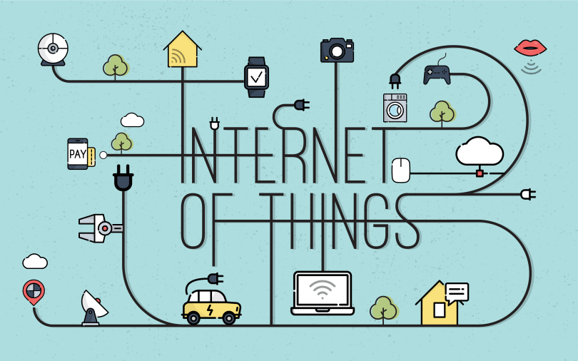

Slide 2
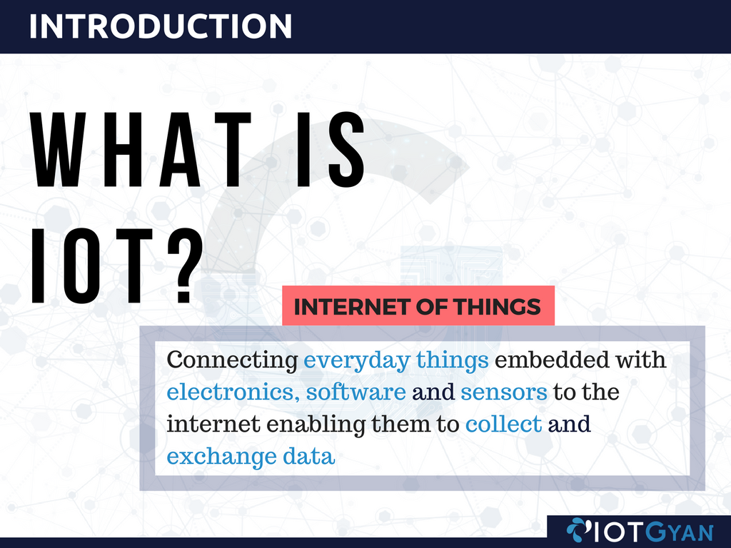


WHAT IS IoT?

Slide 3

BENEFITS OF IOT
Technical Optimization
Improved Data Collection
Improved Performance
Improved Customer Engagement
New revenue streams

Slide 4


APPLICATIONS OF IoT
Electrical
IOT

Slide 5
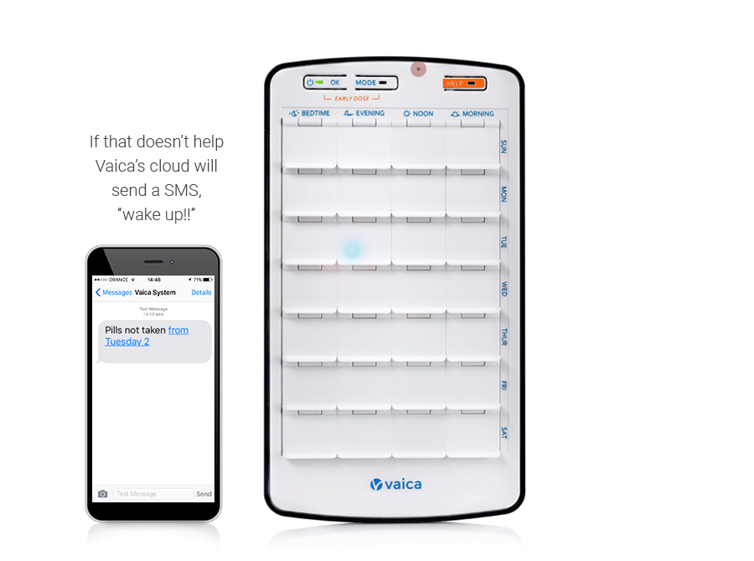
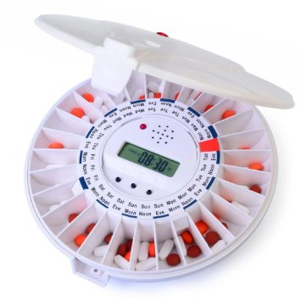

APPLICATIONS OF IoT
AUTOMATION
IOT

Slide 6
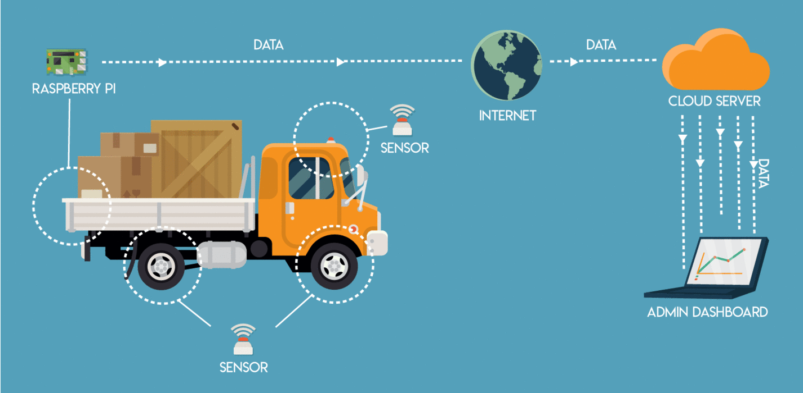

APPLICATIONS OF IoT
Mechanical
IOT

Slide 7
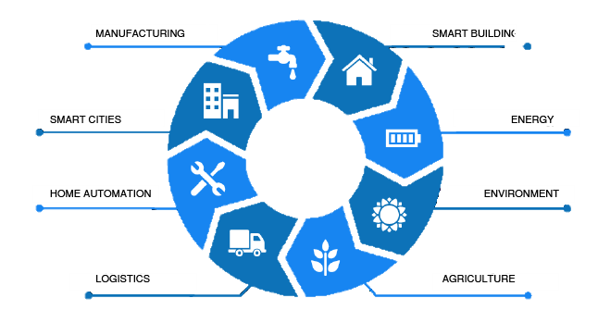
APPLICATIONS IN DIFFERENT SECTORS
HEALTH & LIFE STYLE
HOME AUTOMATION
Wearable Electronics
Health & Fitness Monitoring
Smart Lighting
Smart Appliance
Smart Security Systems
Internet
of
Things
Smart Parking
Smart Roads
Emergency Response
Smart Grids
Renewable Energy Systems
Prognostics
INDUSTRIES
Machine Diagnosis
Indoor Air Quality Monitoring
Weather Monitoring
Forest Fire Detection
Air Pollution
Shipment Monitoring
Remote vehicle Diagnostics
Fleet Tracking
Smart Irrigation
Green House

Slide 8
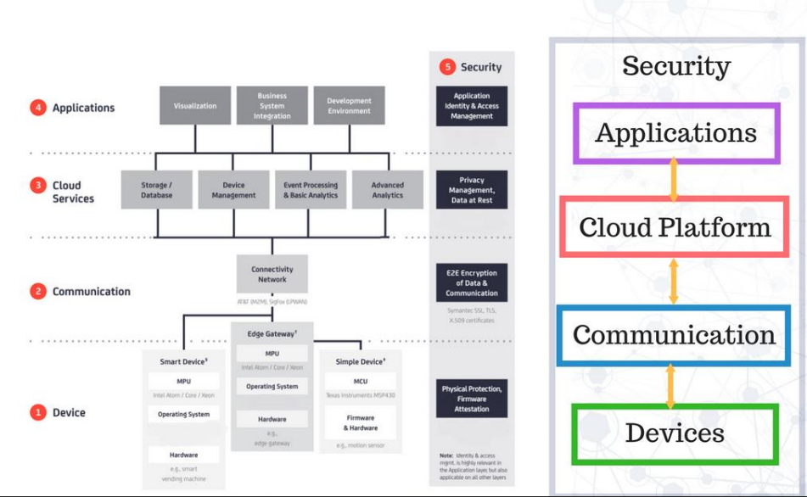
IoT ARCHITECTURE

Slide 9
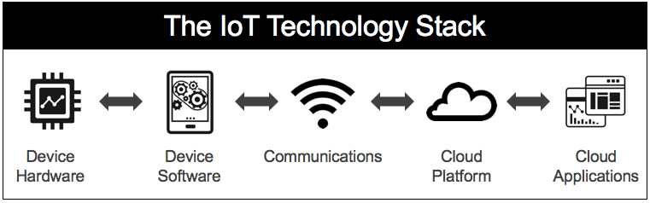
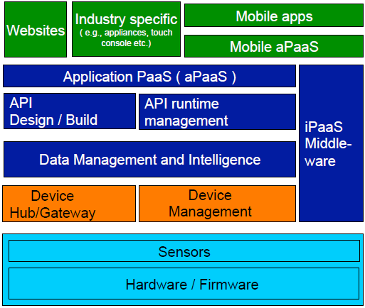
IoT TECHNOLOGY STACK

Slide 10




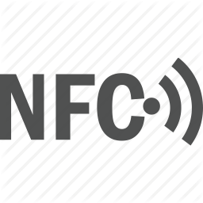









































IOT TECHNOLOGY STACK

Slide 11
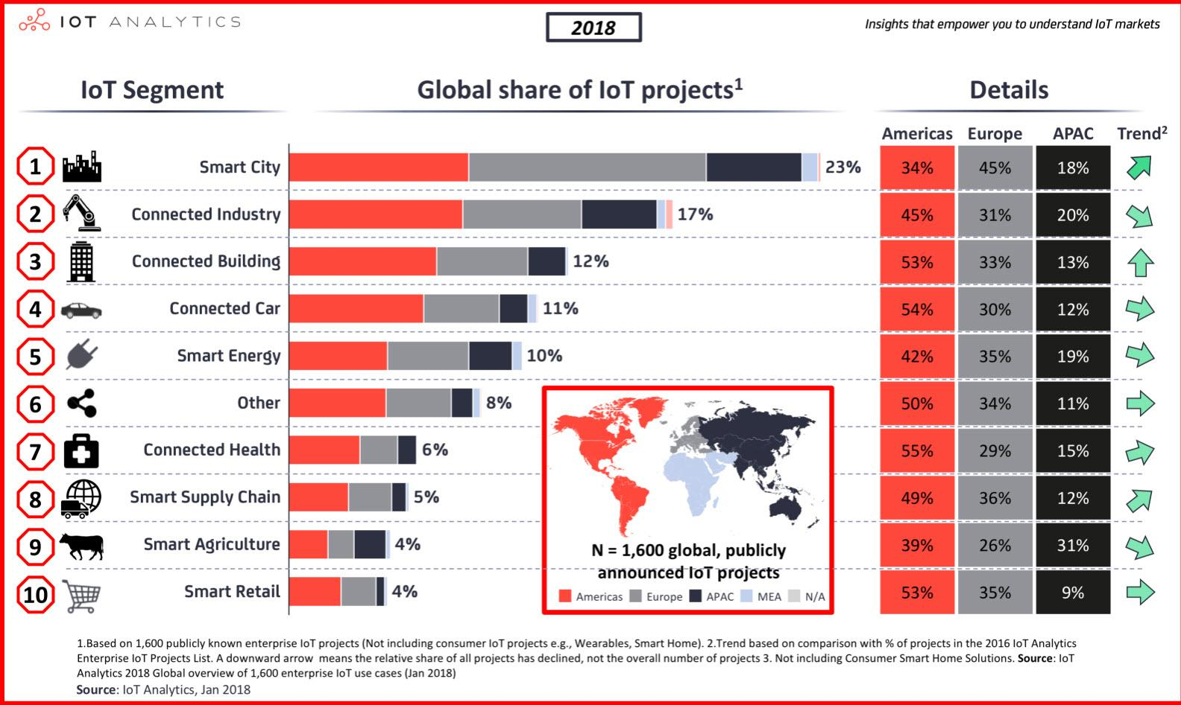
IoT Statistics

Slide 12
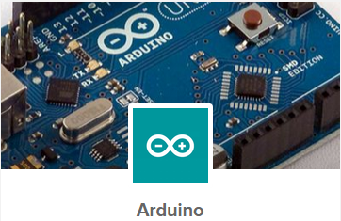
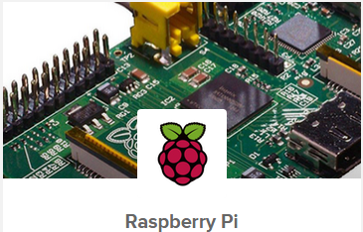

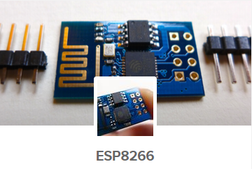
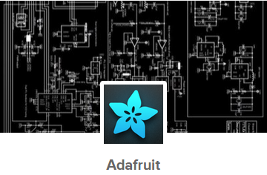
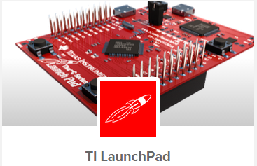

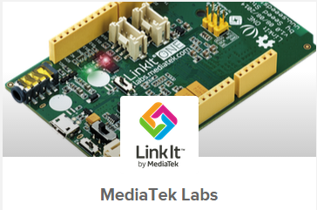
PROTOTYPING HARDWARE

Slide 13










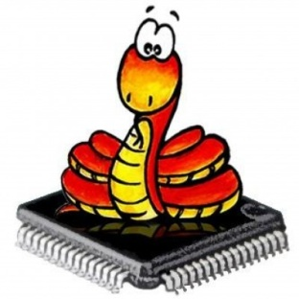

SOFTWARE

Slide 14
PROTOTYPING HARDWARE
(NODEMCU)

Slide 15
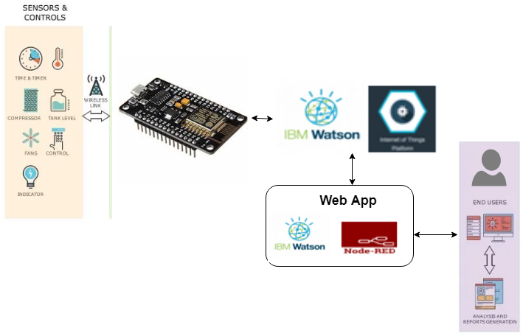
HOW DATA EXCHANGE IN IBM CLOUD

Slide 16
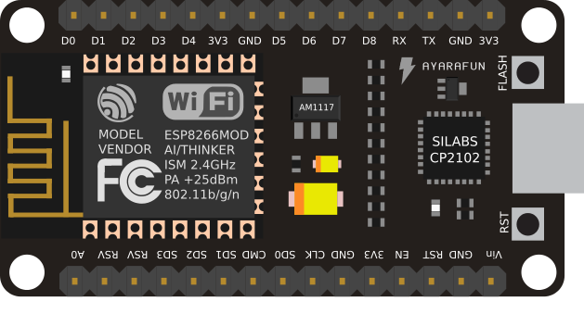
ESP8266 – (NODEMCU DEV 1.0)
Node MCU development board is an open-source IOT development kit.
It includes firmware which runs on the ESP8266 Wi-Fi SoC from Espressif Systems, and hardware which is based on the ESP-12E module.
The term "NodeMCU" by default refers to the firmware rather than the dev kits. The firmware uses the Lua scripting language.
It is a low cost hardware platform available for development of IOT applications

Slide 17
ESP8266 – (NODEMCU DEV 1.0)
ESP8266 is high integration wireless SOC
ESP-12E Wi-Fi module is developed by Ai-thinker Team
Integrated low power 32-bit MCU - Tensilica L106, with 4MB Flash memory, 128KB SRAM
Clock speed support 80 MHz and over clock 160 MHz,
Integrated 10-bit ADC and 13 GPIO’s
Integrated TCP/IP protocol stack
Supports IEEE 802.11 b/g/n , Wi-Fi 2.4 GHz, WPA/WPA2 , +20dBm output power
Support STA/AP/STA+AP operation modes
Integrated UART, I2C, I2S, IRDA, PWM, GPIO, SDIO 2.0, (H) SPI interface
Deep sleep power <10uA, Standby power consumption less than 1.0mW
Supports the RTOS (Real-Time Operating System)

Slide 18
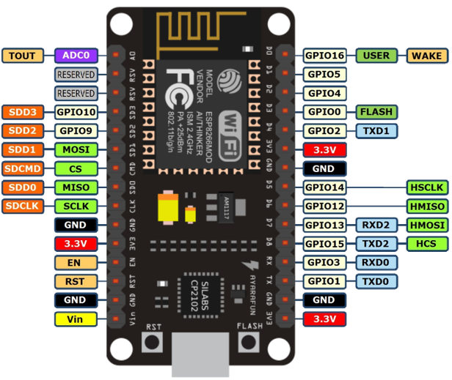

Slide 19
ESP8266 – (NODEMCU DEV 1.0)
NodeMCU - Pin Description
Board Number | Pin Name | Interface | Purpose
D5,D6,D7,D8 | GPIO12, GPIO13, GPIO14, GPIO15 | HSPI | To interface SPI Flash, Display Screen, Another MCU etc.
D2, D5, D6, D8 | GPIO4, GPIO13, GPIO14, GPIO15 | PWM | PWM interface to control LED's, Buzzers etc.
A0 | TOUT | ADC | A 10 bit ADC.
D1, D2 | GPIO4, GPIO5 | I2C | I2C interface to connect Sensors and Display (OLED)
TX, RX | GPIO1, GPIO3 | UART0 | Devices with UART inteface can be connected with the board
D4 | GPIO2 | UART1 | transmit only, can be used to print debugging information
D5,D6,D7 D8,RX,D4 | GPIO14, GPIO12, GPIO13 (I2S Input) GPIO15, GPIO3, GPIO2 (I2S Output) | I2S | I2S interface is mainly used to collecting, processing, and transmission of audio data

Slide 20
ESP8266 – (NODEMCU DEV 1.0)
NodeMCU - Pin Description
Board Number | Pin Name | Interface | Purpose
D1, D5 | GPIO5, GPIO14 | IR Remote Control | IR Remote control interface.
D1 - D8 | GPIO5, GPIO4, GPIO0, GPIO2, GPIO14, GPIO12, GPIO13, GPIO15 | GPIO | Digital IO's with PWM Functionality
D0 | GPIO16 | GPIO | Digital IO only with Built in LED
SD2, SD3 | GPIO9,GPIO10 | GPIO | Digital IO only
EN | EN | EN | Chip Enable pin, Ground the pin to disable board
RST | RST | RST | External RESET of the board
Vin | Vin | Vin | Input power supply 4.5V to 9V
3.3V, GND | 3.3V, GND | 3.3V, GND | 3.3V power output for sensors

Slide 21
SOFTWARE
(ARDUINO)

Slide 22
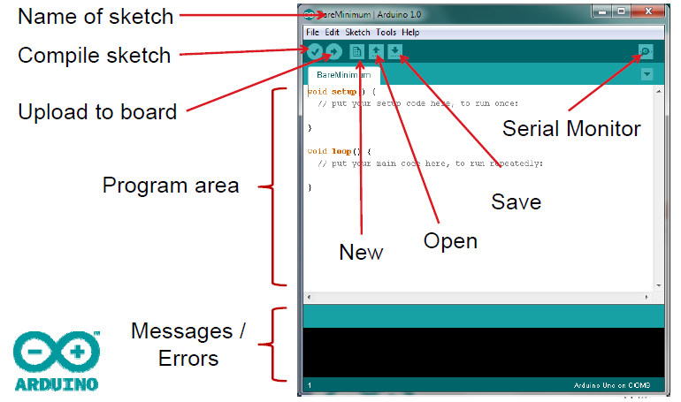
INTRODUCTION TO ARDUINO IDE

Slide 23
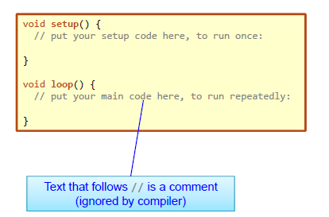
INTRODUCTION TO ARDUINO IDE
void setup()
Will be executed only when the program begins or( reset button is pressed)
void loop()
Will be executed repeatedly

Slide 24
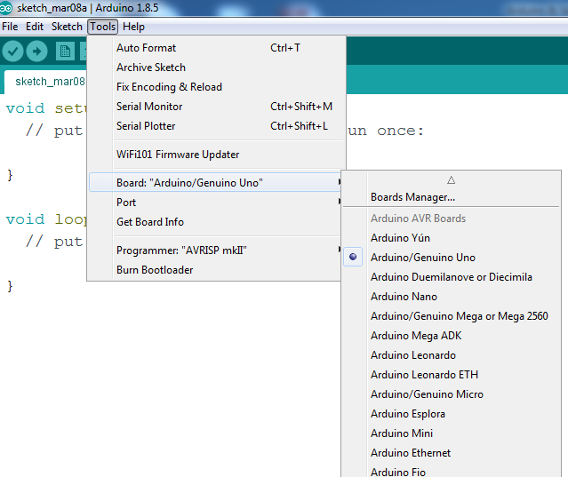
BOARDS MANAGER

Slide 25
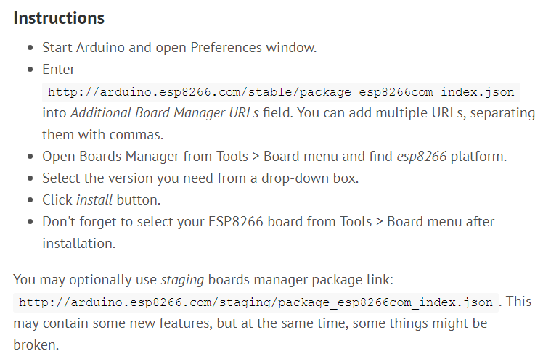
BOARDS MANAGER

Slide 26
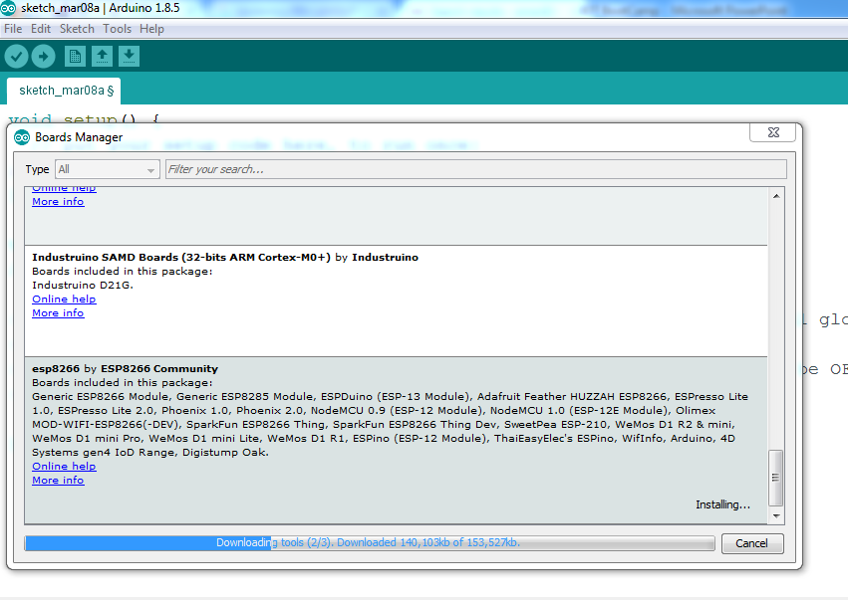
BOARDS MANAGER

Slide 27
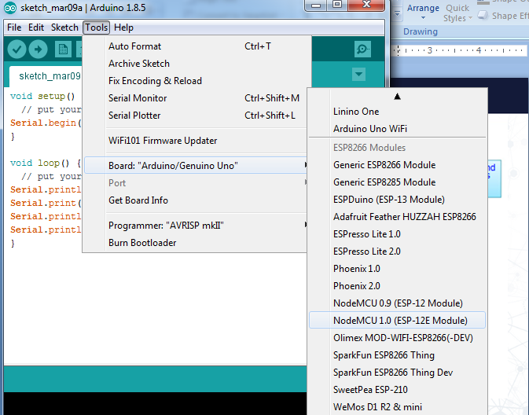
BOARDS MANAGER

Slide 28
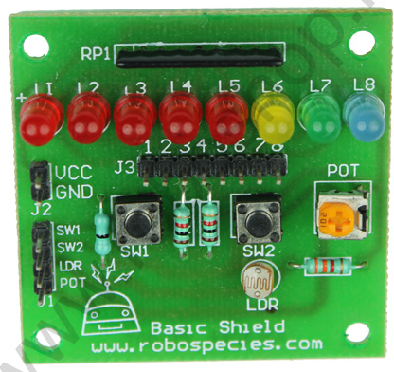
BASIC SHIELD
Basic Shield is used for simulating input & output devices (Analog Input, Analog Output, Digital Input & Digital Output
Output from Arduino for LED’s
LED’s (DO or AO)
5V/3.3V
GND
Potentio Meter (AI)
Input to Arduino
Push Buttons (DI)
LDR (AI)
Active Low Logic

Slide 29
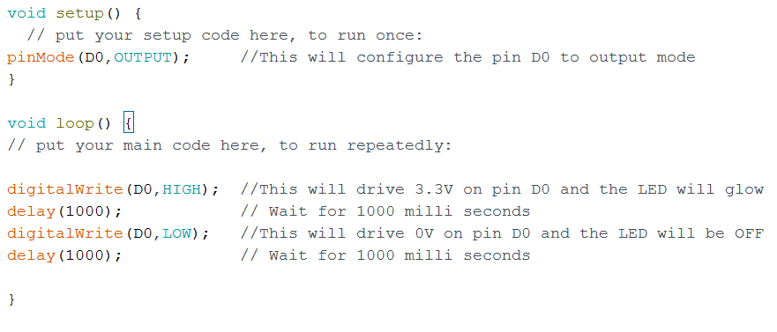
DIGITAL OUTPUT
Configure a digital pin as output pin and control the state of the pin
Circuit Diagram

Slide 30
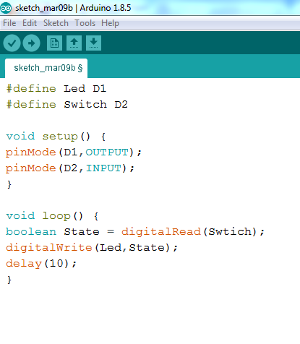
DIGITAL INPUT
Configure a digital pin as input pin and read the state of the pin
Circuit Diagram

Slide 31
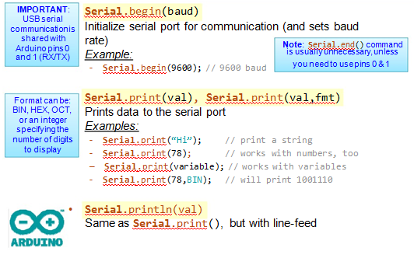
SERIAL MONITOR

Slide 32
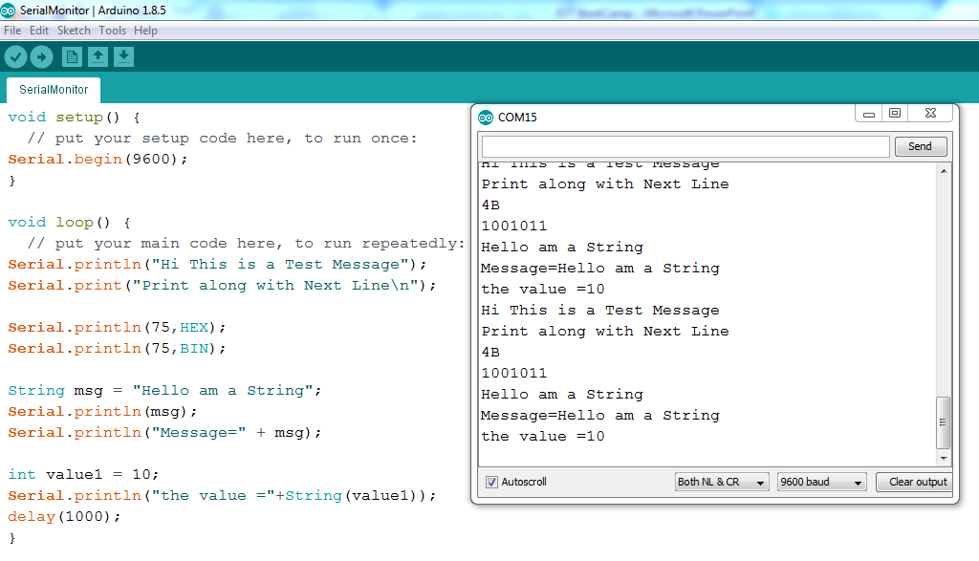
SERIAL MONITOR

Slide 33
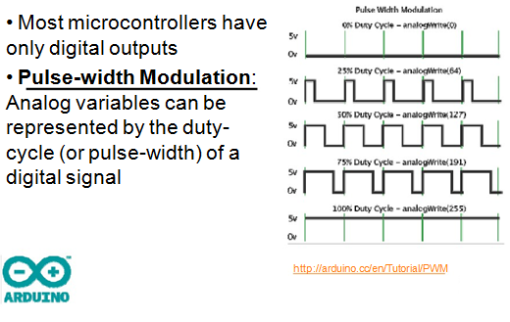
ANALOG OUTPUT

Slide 34
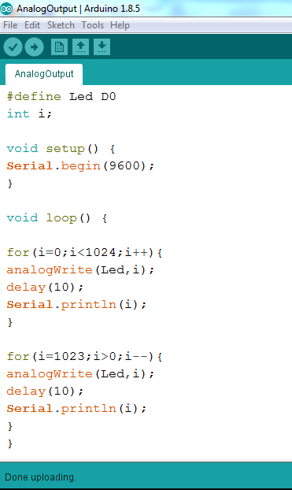
ANALOG OUTPUT
Circuit Diagram

Slide 35
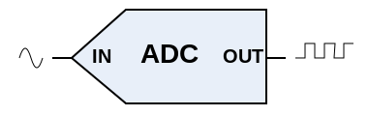
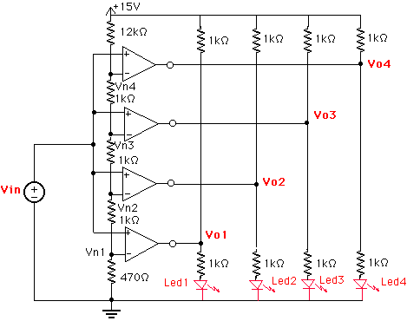
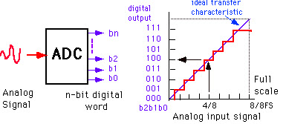
LAB-1.5: ANALOG INPUT

Slide 36
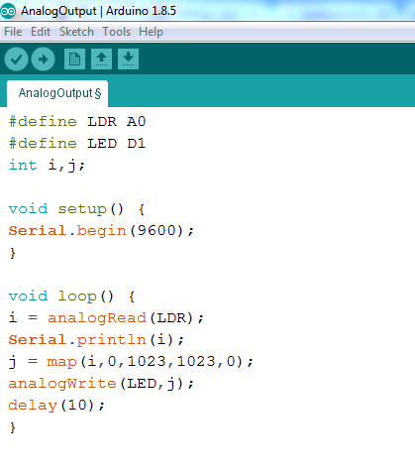
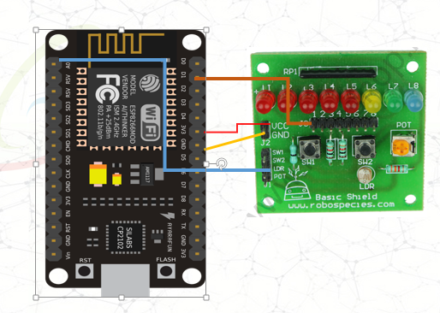
ANALOG INPUT
Circuit Diagram

Slide 37
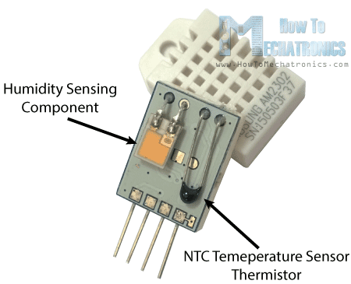
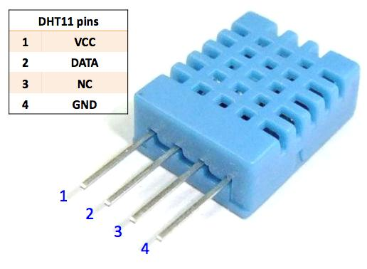
INTEGRATE SENSORS
The DHT11 is a basic, ultra low-cost digital temperature and humidity sensor. It uses a resistive type humidity sensor and a thermistor to measure the surrounding air, and spits out a digital signal on the data pin (no analog input pins needed.

Slide 38
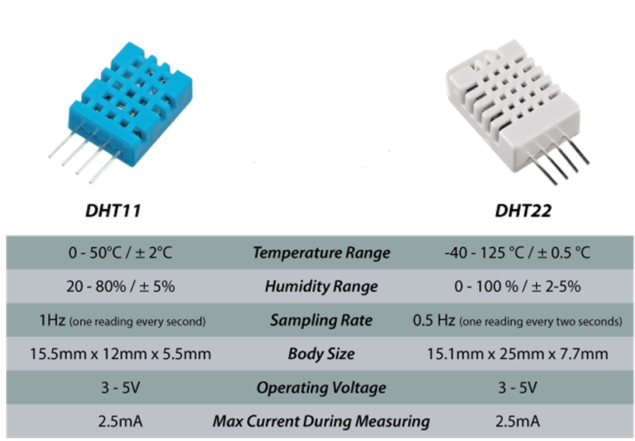
INTEGRATE SENSORS

Slide 39
INTEGRATE SENSORS
Working Principle
Communication process can be separated into three stages
Request
Response
Data processing
Send a “Start” Signal to the DHT-11 (Set the pin to LOW for 18uS and then set it high for at least 20 uS)
Wait for the DHT-11 to respond with a LOW signal for 80 uS followed by a HIGH signal for 80uS
Wait for the DHT-11 to send a “Start to transmit” signal (LOW for 50 microseconds)
Time the HIGH pulse from the DHT-11
If the signal width is between 26 and 28 uS, record a 0 for that bit
If the signal width is 70 uS, record a 1 for that bit
Repeat steps 3 and 4 until 40 bits of data have been transmitted (2 bytes for Temperature, 2 bytes for Humidity and 1 byte for the Checksum)

Slide 40
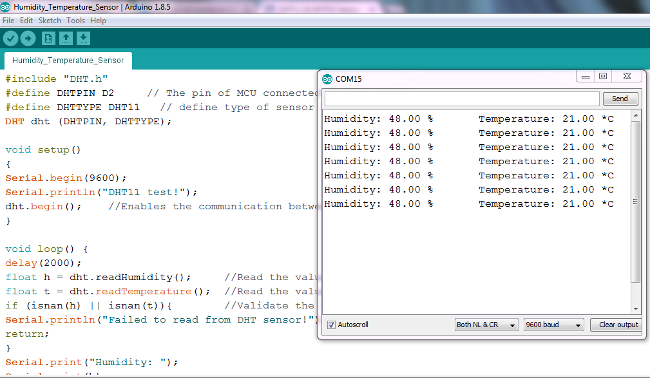
INTEGRATE SENSORS

